Slide 1

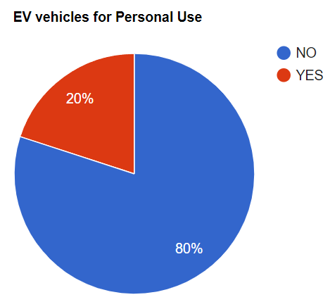
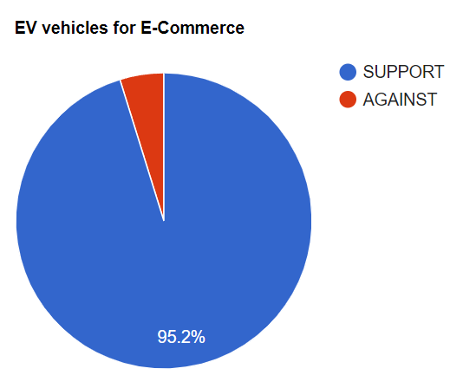
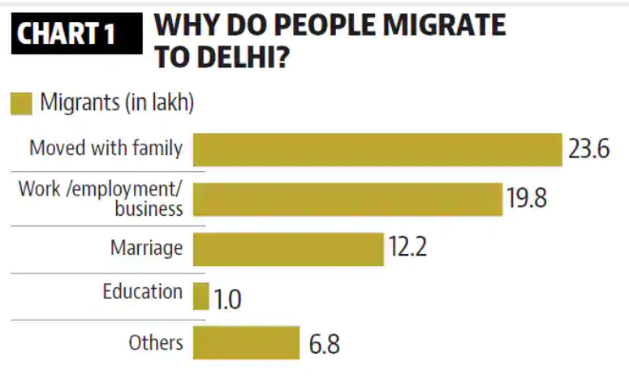
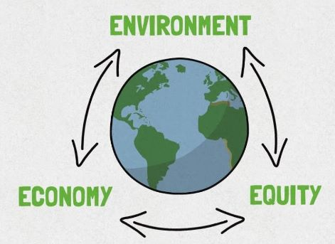
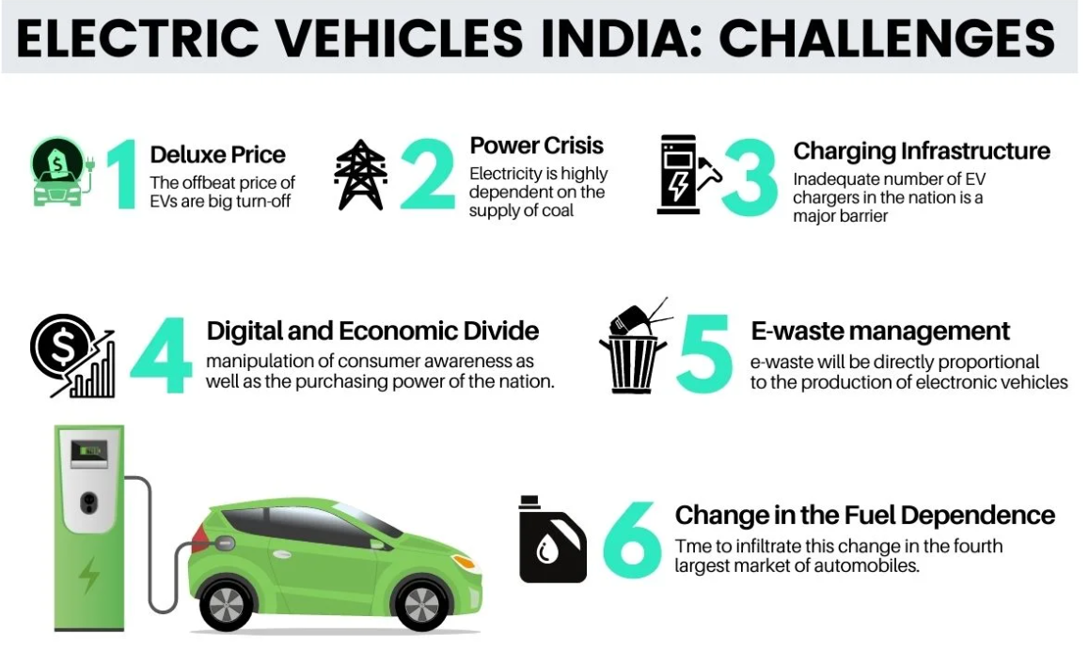
Sustainability, Climate and Urban Development: E - Vehicles and Environmental Governance
Rahul Agarwal - 2020456, Rahul Bansal - 2020457, Samar Preet Singh - 2020464, Kanishk SIngh - 2018044
ABSTRACT
INTRODUCTION
METHODOLOGY
A smart city is defined as the integration of Information and technology (ICT), Modern communication infrastructure(ICT) and also Sustainable economic development plus the quality of life. The aim of a smart city in India is providing a better quality of life to its citizen, Delhi is the capital city of India, which is highly dense and most populated city due to unplanned urbanization, overgrowth population, environmental challenges, mismanagement of solid waste and social exclusion. Smart city action fields that govern the development of smart governance, economy, mobility, environment, people and smart living for this its need better urban management. The digitalization of the power grid to smart grid provides value added services to the prosumers and other stakeholders involved in the energy market, and possibly disrupts existing electricity services in smart cities. The use of Electric Vehicles (EVs) do not only challenge the sustainability of the smart grid but also promote and stimulate its upgrading. The integration of EVs could bring substantial changes for the society not only in providing transportation services but also shifting economies from petroleum and reducing the carbon dioxide (CO2) emission from the transportation sector.
Urban sustainable development is a collective concept that underpins within it the individual wellbeing. It is important to meet the needs of the present generation, especially the poor, keeping in mind the environment’s ability to
meet the needs of the future.
As a consequence of climate change concerns, the automotive industry is facing major investments targeting to reduce the dependence from fossil fuels. Therefore, the transportation sector is changing to the electric mobility paradigm, entailing a set of important questions about sustainability, namely about the required electricity for driving an electric vehicle, the environmental impacts due to require energy to produce the EV (including the batteries), and consequences related with recycling materials and the EV end-of-life.
Electric Vehicles
So, we each asked around 95-100 people.(The sample size is 100 people, equally distributed between men and women, workers and private car users) These people already owned a car and belonged to a middle class or upper middle class family whether they would buy electric cars. Around 80% of people declined, only around 20% will shift towards electric cars.
80% of people are inclined towards high cost, less distance range, maintenance service availability, and battery life durability.
But in contrast According to a survey, 95.2 per cent of the respondents agreed that a switch to EVs by delivery companies is important for addressing air pollution issues and mitigating climate change.
Urbanization
Nearly, 4 of 5 families in Delhi-NCR are affected by air pollution, shows a survey. 22 percent of the respondents said they or someone in their family already visited doctors or hospitals regarding this pollution-related ailment.
Among all the states,Delhi has the highest share of inter-state migrants , below an indicator of the attraction it holds for outsiders.
ARGUMENTS
Electric Vehicles
high cost
less distance range
maintenance service availability
battery life durability
Urbanization
Overcrowding
Degradation of environmental quality
Health Problems
Transport problems
QUESTIONS
Que 1: Is electric cars a viable option compared to Diesel/Petrol/CNG cars?
From being produced by batteries, electric cars are environmentally friendly, don’t produce any harmful emissions.
Ques2: Is Delhi livable and safe?
To achieve sustainable growth, Delhi must become more livable and safe, with clean air, adequate infrastructure, reliable utilities, and opportunities for learning and job creation. The solution, therefore, lies in inclusive urbanization processes that prioritize the quality of life for all and focus mainly on the needs of disadvantaged urban groups in terms of employment, housing, sanitation, health care, and education.
Ques3 : How Delhi is leading the charge in electric vehicle adoption
The residents of Delhi and adjoining areas are literally gasping for breath with the air quality (AQI) plunging to the "severe" category and a thick blanket of smog enveloping the entire region.Vehicles caused half or around 51% of the national capital's own contribution to PM2. 5 levels from October 21 to 26, therefore there is a urgent need to introduce ev vehicles
CONCLUSIONS
Electric Vehicles will have a great scope in future, and At the end of the decade, 4 out 5 i.e.80% people will have an electric car. Need of smart city is necessary for a better economy, mobility, environment and better AQI.
Lastly, as consequences of climate change, the automotive industry is facing major loss from getting fossil fuel. Thus, Urban sustainable development is needed for future needs.
REFERENCES
Ramesan, S., Kumar, P., & Garg, S. K. (2022). Analyzing the enablers to overcome the challenges in the adoption of electric vehicles in Delhi NCR. Case Studies on Transport Policy, 10(3), 1640-1650.
Kawoosa, V. M. (2019). Delhi has the highest share of Inter-state migrants. Hindustan Times.
Ramesan, S., Kumar, P., & Garg, S. K. (2022). Analyzing the enablers to overcome the challenges in the adoption of electric vehicles in Delhi NCR. Case Studies on Transport Policy, 10(3), 1640–1650.
CONTACT

